Slide 1
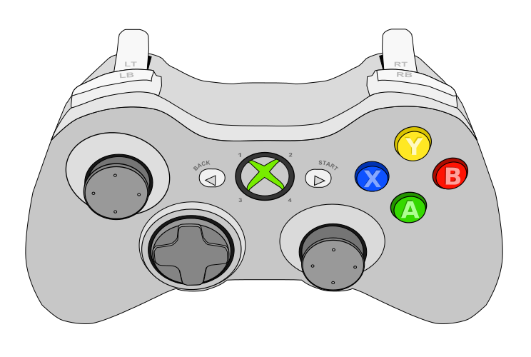
Controller 1
Drive Forward
Strafe Left
Strafe Right
Drive Back
Turn Left
Turn Right

Slide 2
Controller 2
Split Boxes Out
Suck Boxes In
Lower Box Collector
Raise Box Collector
Raise Robot
Lower Robot

Slide 3
Controller 1 for Both
Split Boxes Out
Suck Boxes In
Lower Box Collector
Raise Box Collector
Drive Forward
Raise Robot
Strafe Left
Strafe Right
Lower Robot
Drive Back
Turn Left
Turn Right

